Slide 1

CSCI 466: Networks
Application Layer and HTTP
Reese Pearsall
Fall 2024
https://www.cs.montana.edu/pearsall/classes/fall2024/466/main.html
*All images are stolen from the internet

Slide 2
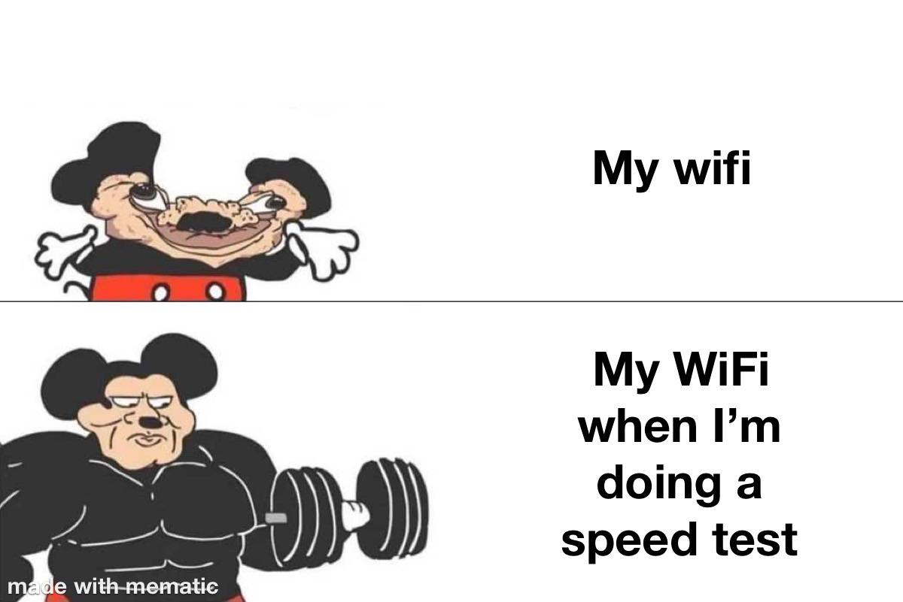
Announcements
No class on Monday
Next week might be funky too

Slide 3
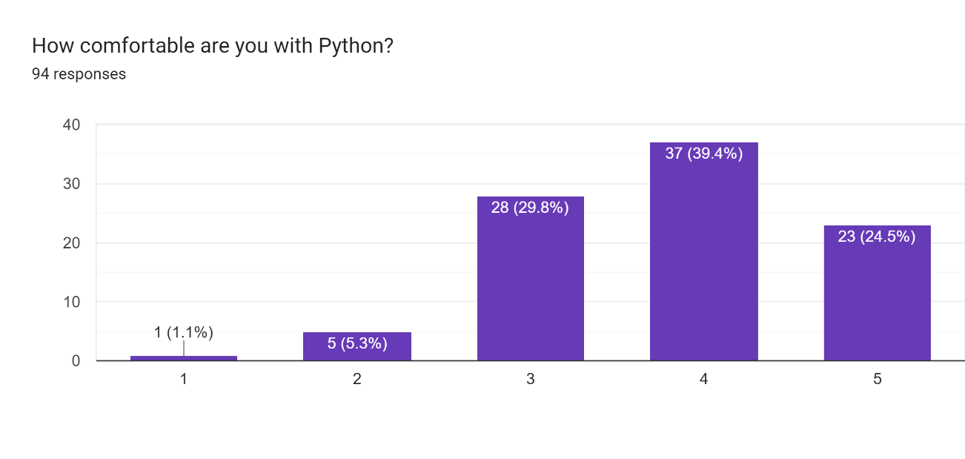
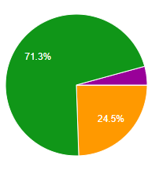

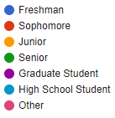



Course Questionnaire
“I tend to procrastinate”
“I’m cooked”
“I’m working full time”

Slide 4

Application Layer
OSI Model
Presentation Layer
*
Application Layer
Session Layer
*
Messages from Network Applications
Transport Layer
Network Layer
Physical Layer
Data Link Layer
Bits being transmitted over a copper wire
Physical Layer
*In the textbook, they condense it to a 5-layer model, but 7 layers is what is most used

Slide 5






Application Layer
OSI Model
???
???
???

Slide 6


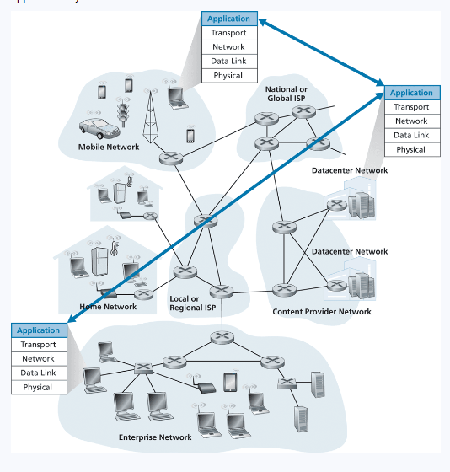







Application Layer Principles
Web applications are built with different technologies
We need a universal method for communicating between applications connected to the internet
New web applications need to be “compatible” with other web applications they communicate with

Slide 7
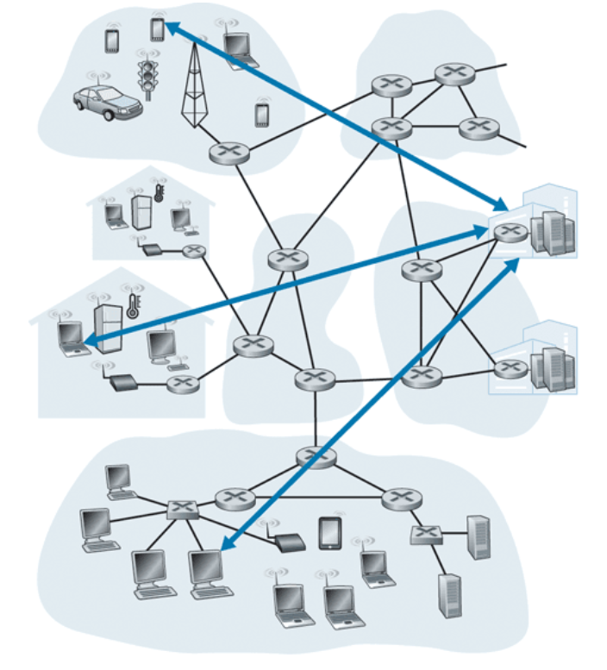
Web Application Architectures
“Server”
Client-server architecture
Clients do not directly interact with each other
“Client”

Slide 8
Web Application Architectures
“Server”
Client-server architecture
Clients do not directly interact with each other
“Client”
ie. My web browser does not directly interact with your web browser

Slide 9


Web Application Architectures
“Server”
Client-server architecture
Clients do not directly interact with each other
“Client”
ie. My web browser does not directly interact with your web browser
Communication is done through a Server
Online 24/7*
Hosted in a data center

Slide 10
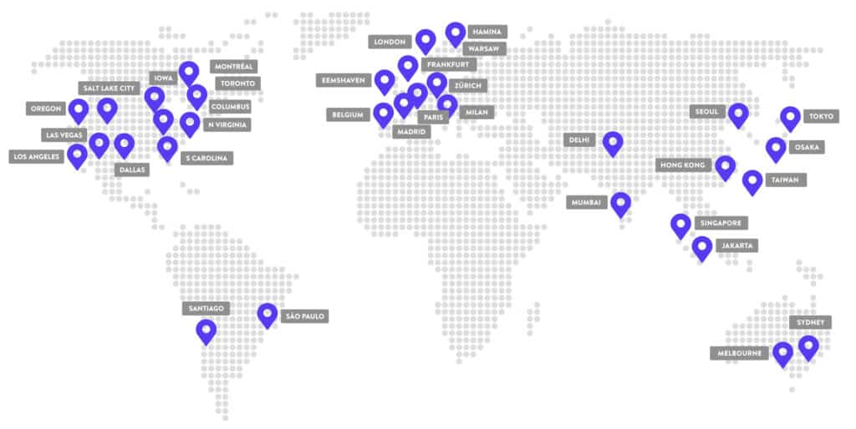
Web Application Architectures
“Server”
Client-server architecture
Clients do not directly interact with each other
“Client”
ie. My web browser does not directly interact with your web browser
Communication is done through a Server
Online 24/7*
Hosted in a data center

Slide 11
Application Requirements
What type of services do different applications need from the network?
Application | Data Loss | Throughput | Time Sensitive

Slide 12



Application Requirements
What type of services do different applications need from the network?
Application | Data Loss | Throughput | Time Sensitive
Can the application tolerate potential loss of data?
Does the application require a specific bandwidth/throughput value?
Do endpoints need to receive data within X amount of time? Is delay allowed?

Slide 13
Application Requirements
What type of services do different applications need from the network?
Application | Data Loss | Throughput | Time Sensitive
File Transfer | No loss | Elastic | No

Slide 14
Application Requirements
What type of services do different applications need from the network?
Application | Data Loss | Throughput | Time Sensitive
File Transfer | No loss | Elastic | No
Email | No loss | Elastic | No

Slide 15
Application Requirements
What type of services do different applications need from the network?
Application | Data Loss | Throughput | Time Sensitive
File Transfer | No loss | Elastic | No
Email | No loss | Elastic | No
Web Browsing | No loss | Elastic | No → Yes

Slide 16
Application Requirements
What type of services do different applications need from the network?
Application | Data Loss | Throughput | Time Sensitive
File Transfer | No loss | Elastic | No
Email | No loss | Elastic | No
Web Browsing | No loss | Elastic | No → Yes
Real-Time Audio | Loss-Tolerant | Inelastic | Yes

Slide 17
Application Requirements
What type of services do different applications need from the network?
Application | Data Loss | Throughput | Time Sensitive
File Transfer | No loss | Elastic | No
Email | No loss | Elastic | No
Web Browsing | No loss | Elastic | No → Yes
Real-Time Audio | Loss-Tolerant | Inelastic | Yes
Stored Video | Loss-Tolerant | Elastic | No

Slide 18
Application Requirements
What type of services do different applications need from the network?
Application | Data Loss | Throughput | Time Sensitive
File Transfer | No loss | Elastic | No
Email | No loss | Elastic | No
Web Browsing | No loss | Elastic | No → Yes
Real-Time Audio | Loss-Tolerant | Inelastic | Yes
Stored Video | Loss-Tolerant | Elastic | No
Interactive Games | Loss-Tolerant | Inelastic | Yes

Slide 19
Application Requirements
What type of services do different applications need from the network?
Application | Data Loss | Throughput | Time Sensitive
File Transfer | No loss | Elastic | No
Email | No loss | Elastic | No
Web Browsing | No loss | Elastic | No → Yes
Real-Time Audio | Loss-Tolerant | Inelastic | Yes
Stored Video | Loss-Tolerant | Elastic | No
Interactive Games | Loss-Tolerant | Inelastic | Yes
Text Messaging | No loss | Elastic | No

Slide 20
Application Requirements
What type of services do different applications need from the network?
Application | Data Loss | Throughput | Time Sensitive | Security
File Transfer | No loss | Elastic | No | ???
Email | No loss | Elastic | No | Need Security
Web Browsing | No loss | Elastic | No → Yes | Need Security
Real-Time Audio | Loss-Tolerant | Inelastic | Yes | ???
Stored Video | Loss-Tolerant | Elastic | No | ???
Interactive Games | Loss-Tolerant | Inelastic | Yes | Don’t need security
Text Messaging | No loss | Elastic | No | Need Security

Slide 21
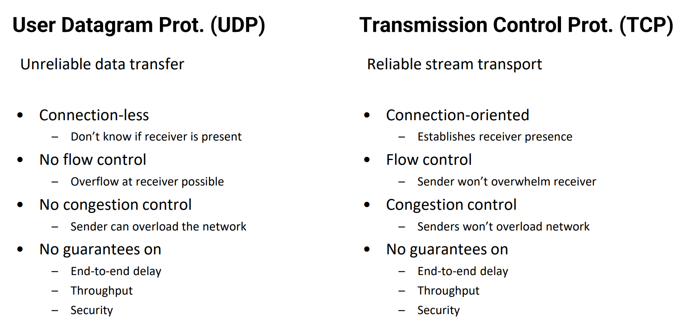
Transport Layer Protocols
Application Layer
Transport Layer

Slide 22
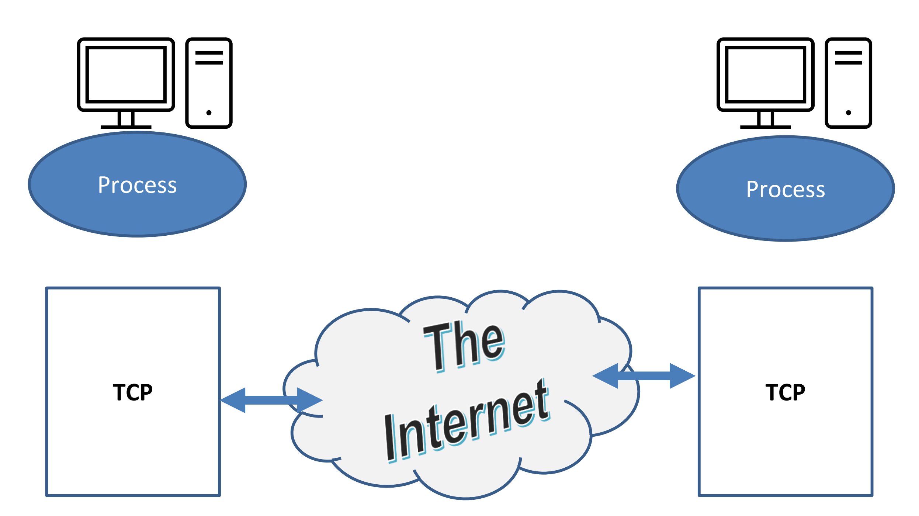
Application to Transport Interface

Slide 23
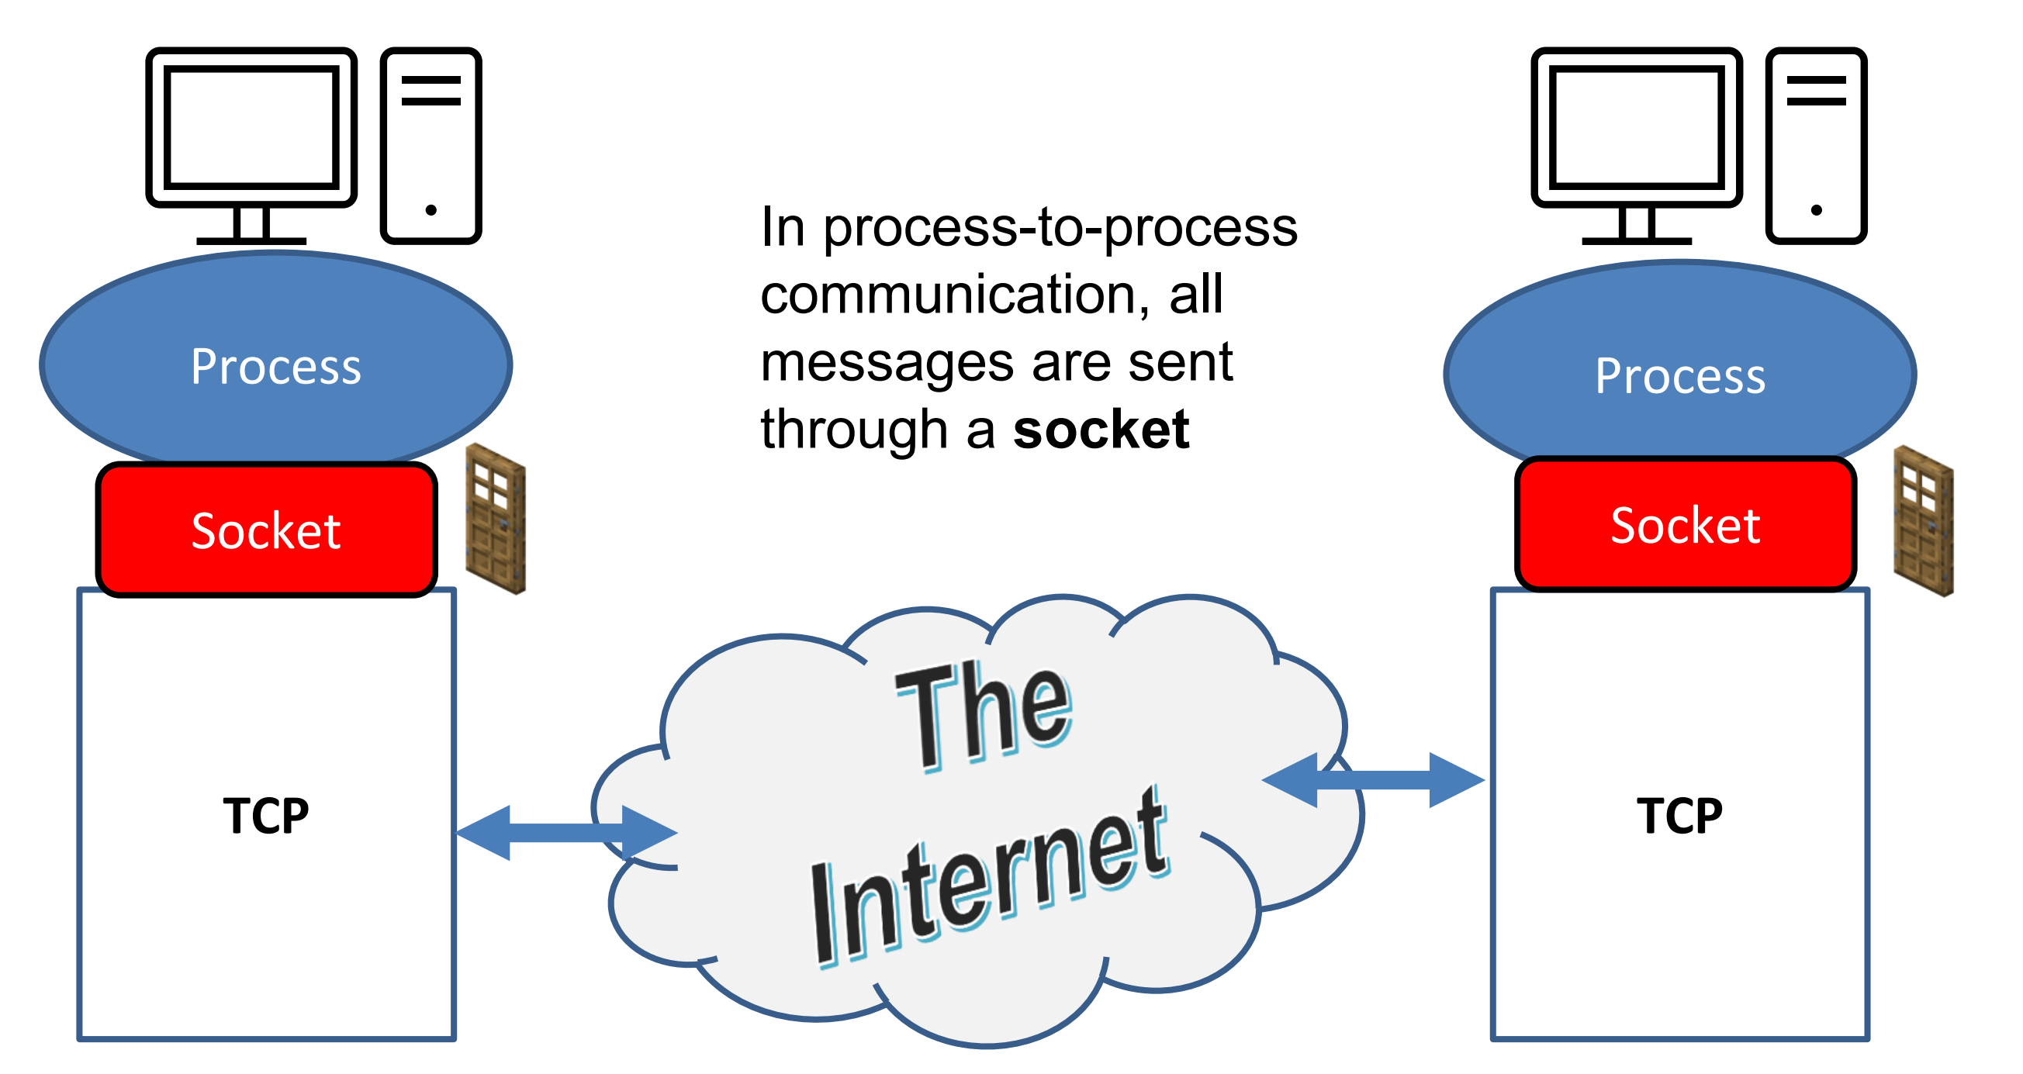
Application to Transport Interface
Option 1: Application sends messages through a TCP socket

Slide 24
Application to Transport Interface
UDP
UDP
Option 2: Application sends messages through a UDP socket

Slide 25
Application Layer Protocols
HyperText Transfer Protocol (HTTP)- protocol that dictates the transmitting of hypermedia documents, such as HTML and other webpage objects
“The language of the web”

Slide 26
Application Layer Protocols
HyperText Transfer Protocol (HTTP)- protocol that dictates the transmitting of hypermedia documents, such as HTML and other webpage objects
“The language of the web”
Uniform Resource Locator (URL)- Addressing scheme for web objects
scheme://domain:port/path_to_object?query_string

Slide 27
Application Layer Protocols
HyperText Transfer Protocol (HTTP)- protocol that dictates the transmitting of hypermedia documents, such as HTML and other webpage objects
“The language of the web”
Uniform Resource Locator (URL)- Addressing scheme for web objects
scheme://domain:port/path_to_object?query_string
http://www.cs.montana.edu/pearsall/classes/fall2023/466/main.html

Slide 28




Application Layer Protocols
HyperText Transfer Protocol (HTTP)- protocol that dictates the transmitting of hypermedia documents, such as HTML and other webpage objects
“The language of the web”
Uniform Resource Locator (URL)- Addressing scheme for web objects
scheme://domain:port/path_to_object?query_string
Web object that is retrieved!
http://www.cs.montana.edu/pearsall/classes/fall2023/466/main.html

Slide 29
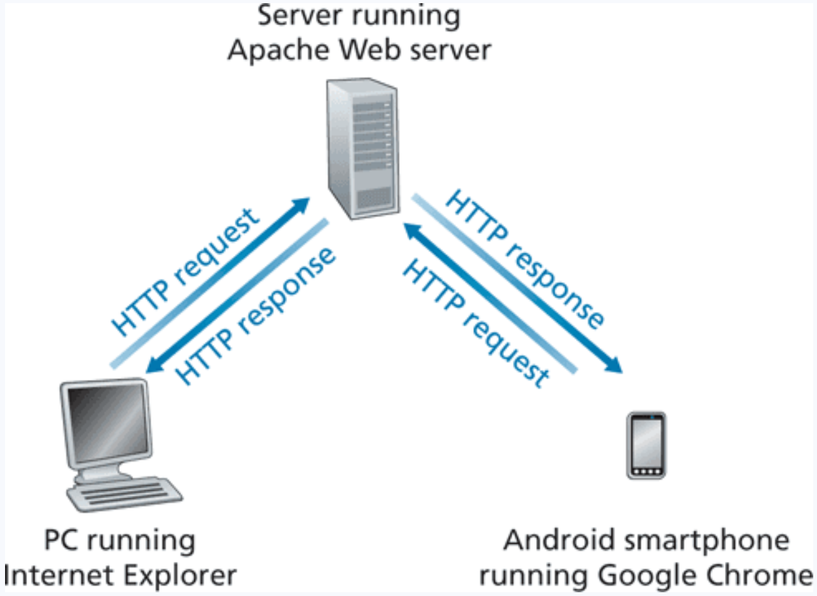
HTTP
HTTP is stateless protocol that acts as a uniform API for different platforms
Built on TCP
HTTP protocol consists of two important pieces
HTTP Request
HTTP Response

Slide 30
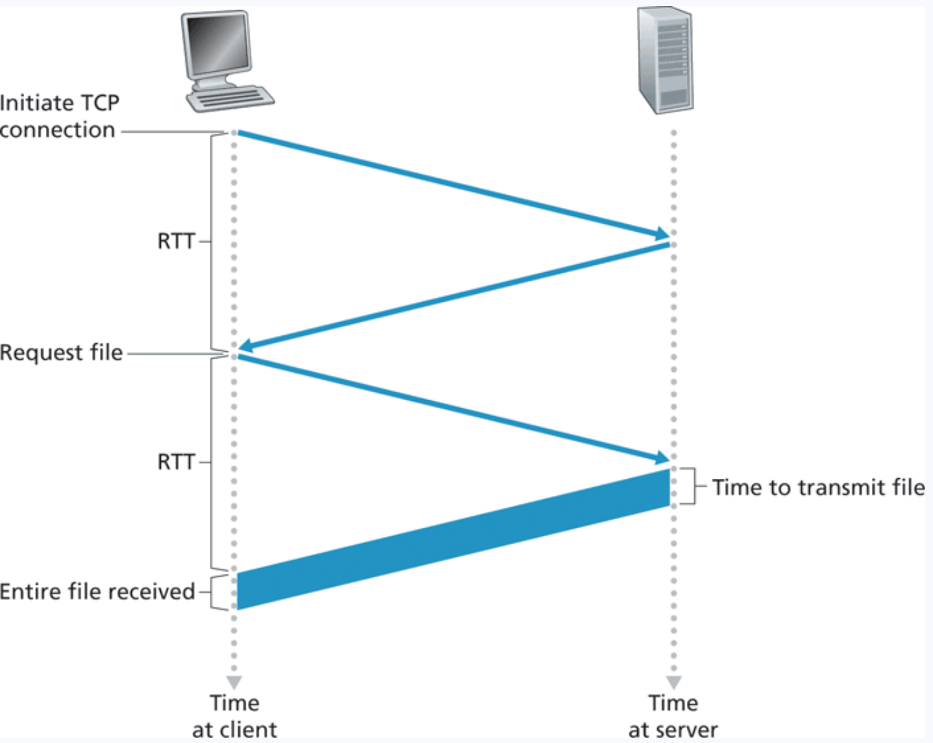
HTTP (Non Persistent)
HTTP can either be persistent or non persistent
Persistent- the same TCP connection is used to transmit all web objects
Non persistent- a new TCP connection is opened for each web object

Slide 31
HTTP (Non Persistent)
HTTP 1.0

Slide 32
HTTP (Non Persistent)
HTTP 1.0
1. HTTP client process initiates a TCP connection to the server on port number 80. A socket is created at both the client and the server
www.someschool.edu

Slide 33
HTTP (Non Persistent)
HTTP 1.0
1. HTTP client process initiates a TCP connection to the server on port number 80. A socket is created at both the client and the server
www.someschool.edu
2. The HTTP client sends an HTTP request to the server via its socket. This request includes the path name for the object

Slide 34
HTTP (Non Persistent)
HTTP 1.0
1. HTTP client process initiates a TCP connection to the server on port number 80. A socket is created at both the client and the server
www.someschool.edu
2. The HTTP client sends an HTTP request to the server via its socket. This request includes the path name for the object
3. The HTTP server process receives the request message via its socket, retrieves the object, encapsulates the object in an HTTP response message, and sends the response message back to client

Slide 35
HTTP (Non Persistent)
HTTP 1.0
1. HTTP client process initiates a TCP connection to the server on port number 80. A socket is created at both the client and the server
www.someschool.edu
2. The HTTP client sends an HTTP request to the server via its socket. This request includes the path name for the object
3. The HTTP server process receives the request message via its socket, retrieves the object, encapsulates the object in an HTTP response message, and sends the response message back to client
4. Client receives the HTTP response. Once entire file is received, then TCP connection is closed
(repeat for each web object)

Slide 36




HTTP (Non Persistent)
HTTP 1.0
1. HTTP client process initiates a TCP connection to the server on port number 80. A socket is created at both the client and the server
www.someschool.edu
2. The HTTP client sends an HTTP request to the server via its socket. This request includes the path name for the object
3. The HTTP server process receives the request message via its socket, retrieves the object, encapsulates the object in an HTTP response message, and sends the response message back to client
4. Client receives the HTTP response. Once entire file is received, then TCP connection is closed
(repeat for each web object)

Slide 37

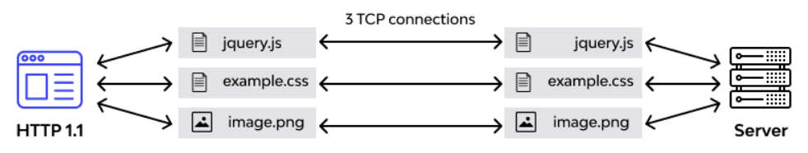
HTTP (Persistent)
HTTP 1.1+
www.someschool.edu
In a persistent HTTP connection, all web objects will be sent through the same TCP connection
Parallelism?

Slide 38
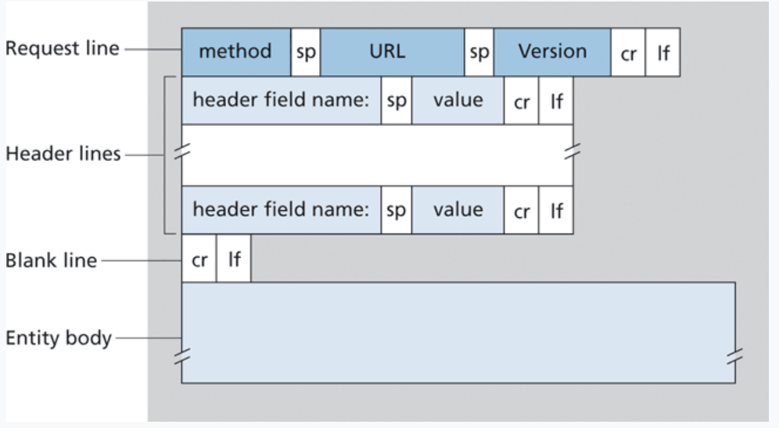
HTTP Format
HTTP Request

Slide 39
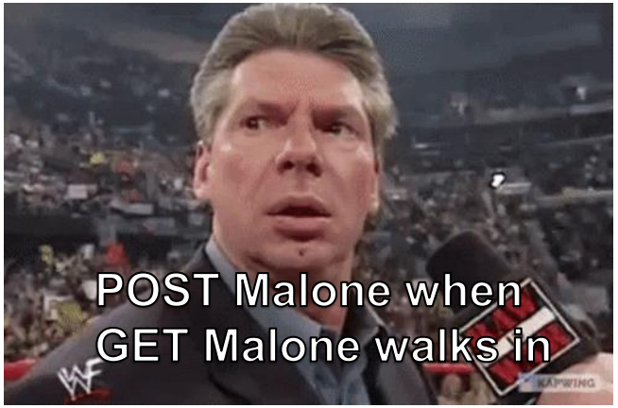
HTTP Format
HTTP Request
GET: Download resource
HEAD: Get resource metadata POST: Upload form contents
PUT: Upload object to URL DELETE: Delete object from URL
Whenever we download a web object from a web page, we issue an HTTP GET request

Slide 40
HTTP Format
HTTP Request
GET: Download resource
HEAD: Get resource metadata POST: Upload form contents
PUT: Upload object to URL DELETE: Delete object from URL
Whenever we download a web object from a web page, we issue an HTTP GET request
www.someschool.edu/dog.jpeg

Slide 41
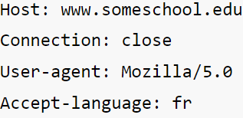
HTTP Format
HTTP Request
GET: Download resource
HEAD: Get resource metadata POST: Upload form contents
PUT: Upload object to URL DELETE: Delete object from URL
Whenever we download a web object from a web page, we issue an HTTP GET request
www.someschool.edu/dog.jpeg

Slide 42
HTTP Format
HTTP Request
GET: Download resource
HEAD: Get resource metadata POST: Upload form contents
PUT: Upload object to URL DELETE: Delete object from URL
Whenever we download a web object from a web page, we issue an HTTP GET request
www.someschool.edu/dog.jpeg
HTTP/1.1

Slide 43
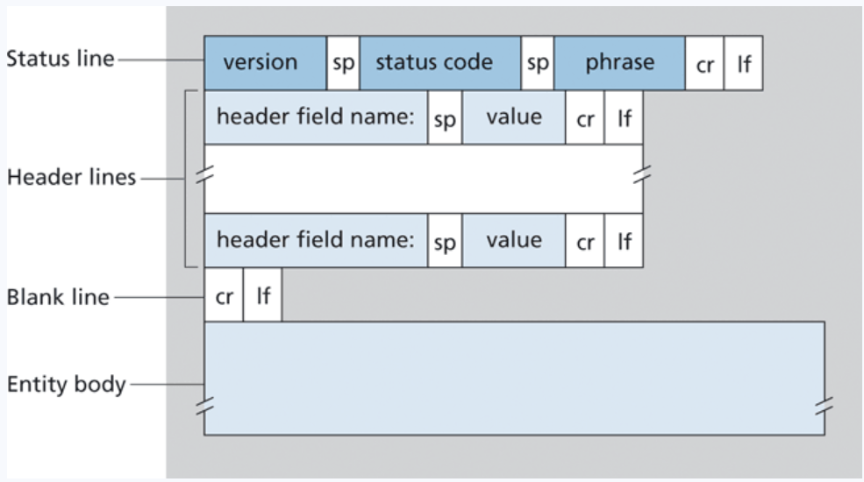
HTTP Format
HTTP Response

Slide 44
HTTP Format
HTTP Response
HTTP/1.1

Slide 45
HTTP Format
HTTP Response
200 - Ok
HTTP/1.1

Slide 46
HTTP Format
HTTP Response
200 – Ok
404 – Not found
HTTP/1.1

Slide 47
HTTP Format
HTTP Response
200 – Ok
404 – Not found
301 – Resource has moved
HTTP/1.1

Slide 48
HTTP Format
HTTP Response
200 – Ok
404 – Not found
301 – Resource has moved
500 – Internal Server Error
HTTP/1.1

Slide 49
HTTP Format
HTTP Response
• Informational Responses (100s)
• Successful Responses (200s)
• Redirection messages (300s)
• Client error response (400s)
• Server error response (500s)
HTTP/1.1

Slide 50
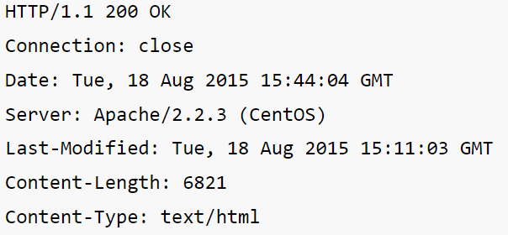
HTTP Format
HTTP Response
• Informational Responses (100s)
• Successful Responses (200s)
• Redirection messages (300s)
• Client error response (400s)
• Server error response (500s)
HTTP/1.1

Slide 51
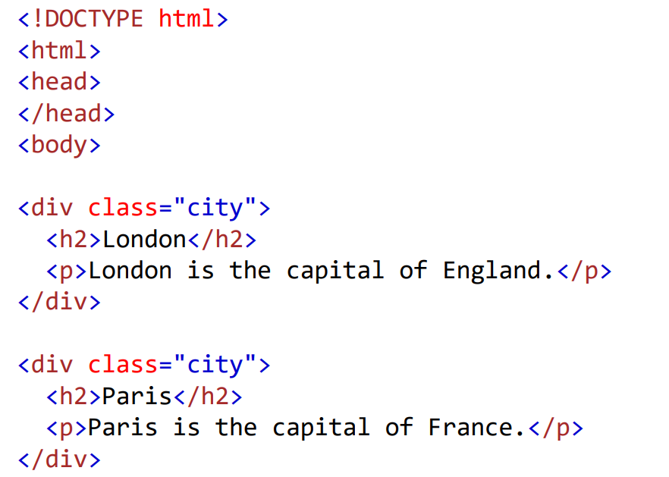
HTTP Format
HTTP Response
• Informational Responses (100s)
• Successful Responses (200s)
• Redirection messages (300s)
• Client error response (400s)
• Server error response (500s)
HTTP/1.1

Slide 52
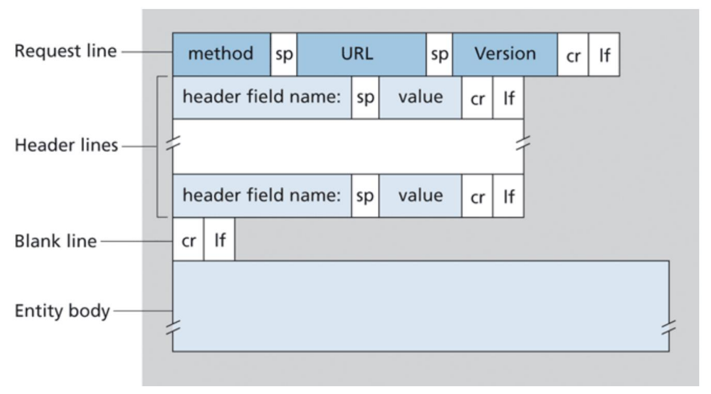
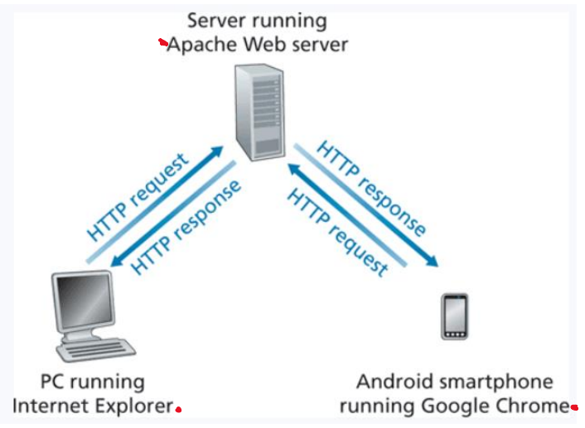
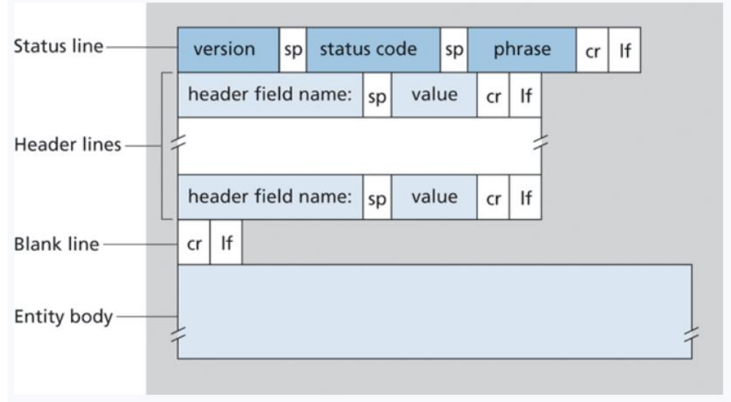
HTTP tl;dr
HyperText Transfer Protocol (HTTP)- protocol that dictates the transmitting of hypermedia documents such as HTML and other webpage objects
REQUEST
All standard web navigation is done through HTTP
RESPONSE

Slide 53
HTTP tl;dr
HyperText Transfer Protocol (HTTP)- protocol that dictates the transmitting of hypermedia documents such as HTML and other webpage objects
REQUEST
All standard web navigation is done through HTTP
HTTPS- is the secure implementation of HTTP
→ Adds encryption and authentication
RESPONSE

Slide 54
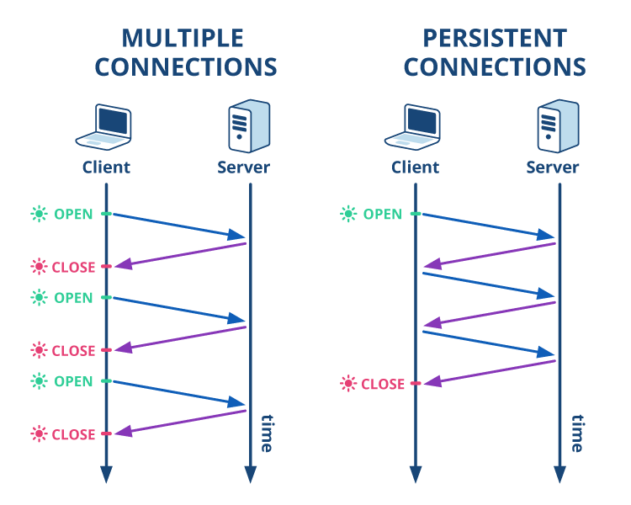
HTTP tl;dr
HyperText Transfer Protocol (HTTP)- protocol that dictates the transmitting of hypermedia documents such as HTML and other webpage objects
REQUEST
All standard web navigation is done through HTTP
RESPONSE

Slide 55
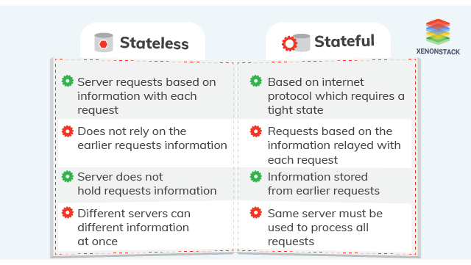
HTTP is a stateless protocol; it does not save information about the sender-receiver session and treats each user as a brand-new connection

Slide 56
HTTP is a stateless protocol; it does not save information about the sender-receiver session and treats each user as a brand-new connection
often it can be useful to identify a user.
User access and permissions
Dynamic continent

Slide 57

Cookies are pieces of information that are exchanged between browsers and web servers to identify users in active connections
Authentication
Tracking & Advertisement
Session Management

Slide 58
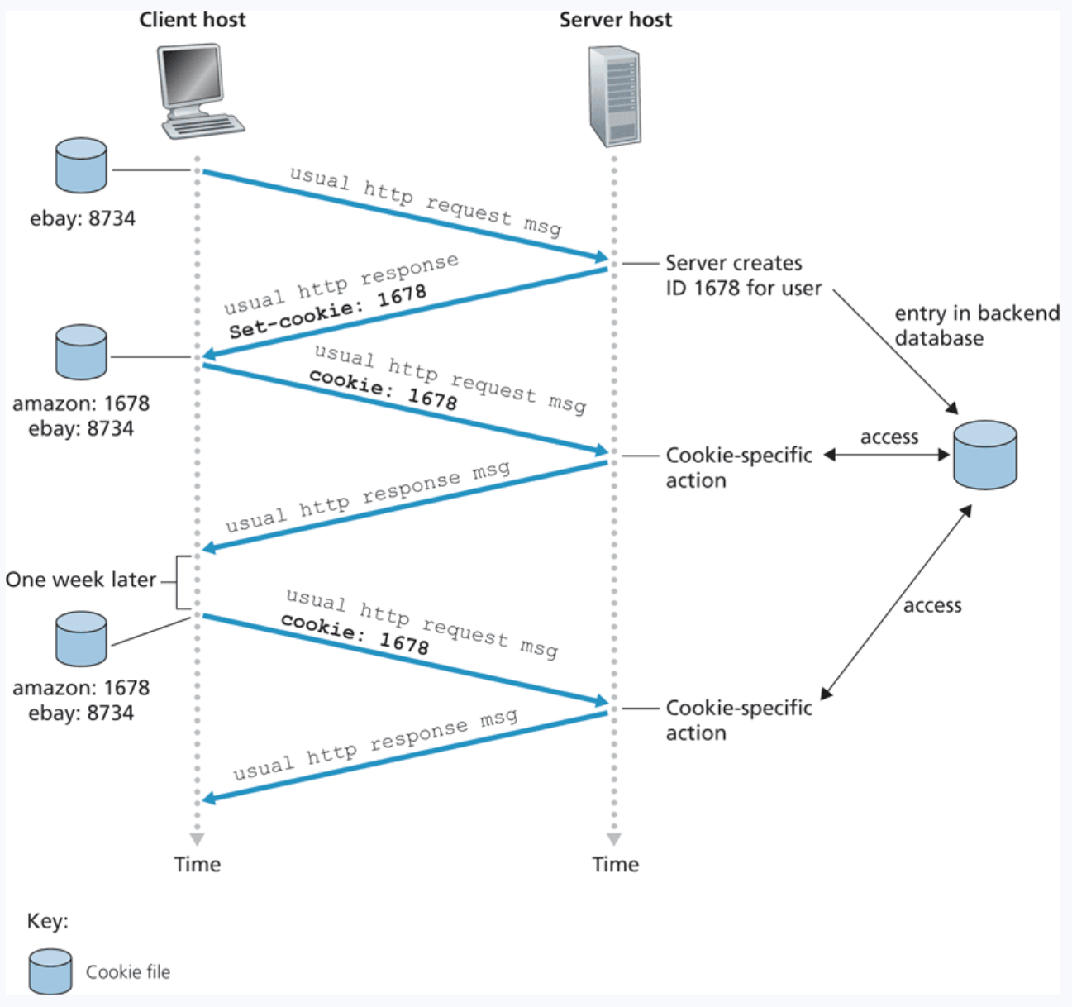
Cookies in HTTP
After sending a request to a webserver for the first time, the user is assigned a unique cookie value

Slide 59
Cookies in HTTP
After sending a request to a webserver for the first time, the user is assigned a unique cookie value
Cookie 1678 is created and stored in the user’s browser as well as some database backend on the server side

Slide 60
Cookies in HTTP
After sending a request to a webserver for the first time, the user is assigned a unique cookie value
Cookie 1678 is created and stored in the user’s browser as well as some database backend on the server side
When the user goes back to visit the website, the cookie will be exchanged between to client and host so the website can execute cookie-specific actions

Slide 61




Cookies in HTTP
After sending a request to a webserver for the first time, the user is assigned a unique cookie value
Cookie 1678 is created and stored in the user’s browser as well as some database backend on the server side
When the user goes back to visit the website, the cookie will be exchanged between to client and host so the website can execute cookie-specific actions

Slide 62

Cookies in HTTP
After sending a request to a webserver for the first time, the user is assigned a unique cookie value
Cookie 1678 is created and stored in the user’s browser as well as some database backend on the server side
When the user goes back to visit the website, the cookie will be exchanged between to client and host so the website can execute cookie-specific actions
There is lots of controversy regarding the privacy and morality of tracking user information with cookies

Slide 63
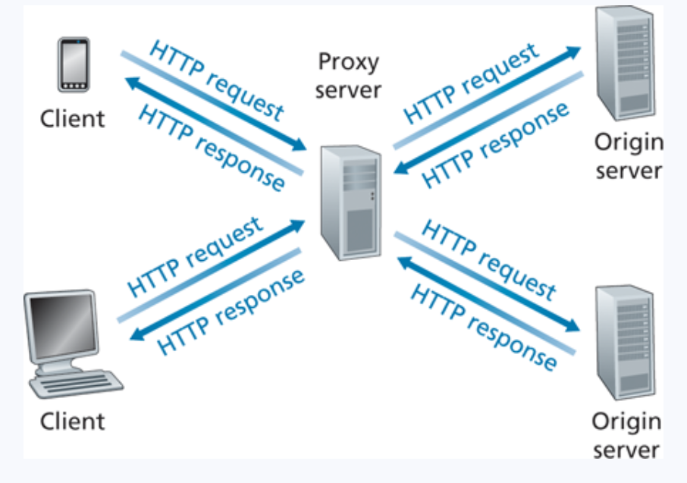
Web Caching
A web cache– also called a proxy server– is a network entity that satisfies HTTP requests on the behalf of an origin Web server

Slide 64
Web Caching
A web cache– also called a proxy server– is a network entity that satisfies HTTP requests on the behalf of an origin Web server
1. Browser/Client establishes a TCP connection to the Web cache and sends an HTTP request

Slide 65
Web Caching
A web cache– also called a proxy server– is a network entity that satisfies HTTP requests on the behalf of an origin Web server
1. Browser/Client establishes a TCP connection to the Web cache and sends an HTTP request
2. Web cache checks its local storage for the requested object

Slide 66
Web Caching
A web cache– also called a proxy server– is a network entity that satisfies HTTP requests on the behalf of an origin Web server
1. Browser/Client establishes a TCP connection to the Web cache and sends an HTTP request
2. Web cache checks its local storage for the requested object
3. If the web cache does not have the object, establish TCP with an origin server and issue an HTTP request

Slide 67
Web Caching
A web cache– also called a proxy server– is a network entity that satisfies HTTP requests on the behalf of an origin Web server
1. Browser/Client establishes a TCP connection to the Web cache and sends an HTTP request
2. Web cache checks its local storage for the requested object
3. If the web cache does not have the object, establish TCP with an origin server and issue an HTTP request
4. Web cache stores a local copy of the object, then issues an HTTP response with the object

Slide 68
Web Caching
Typically installed and maintained by an ISP
A web cache– also called a proxy server– is a network entity that satisfies HTTP requests on the behalf of an origin Web server
1. Browser/Client establishes a TCP connection to the Web cache and sends an HTTP request
2. Web cache checks its local storage for the requested object
3. If the web cache does not have the object, establish TCP with an origin server and issue an HTTP request
4. Web cache stores a local copy of the object, then issues an HTTP response with the object

Slide 69
Web Caching
Typically installed and maintained by an ISP
A web cache– also called a proxy server– is a network entity that satisfies HTTP requests on the behalf of an origin Web server
* Improves response time (especially if the cache has the object that is requested)
* The connection from the client to the cache is typically much faster than the connection from client to host server

Slide 70
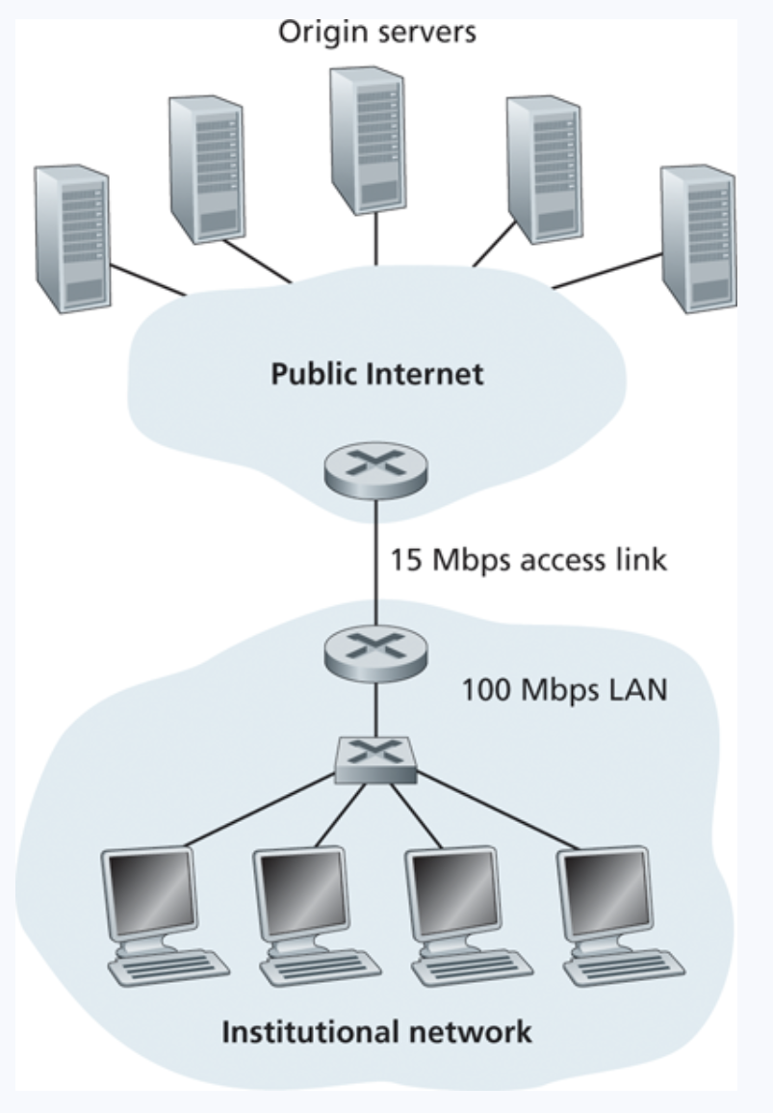
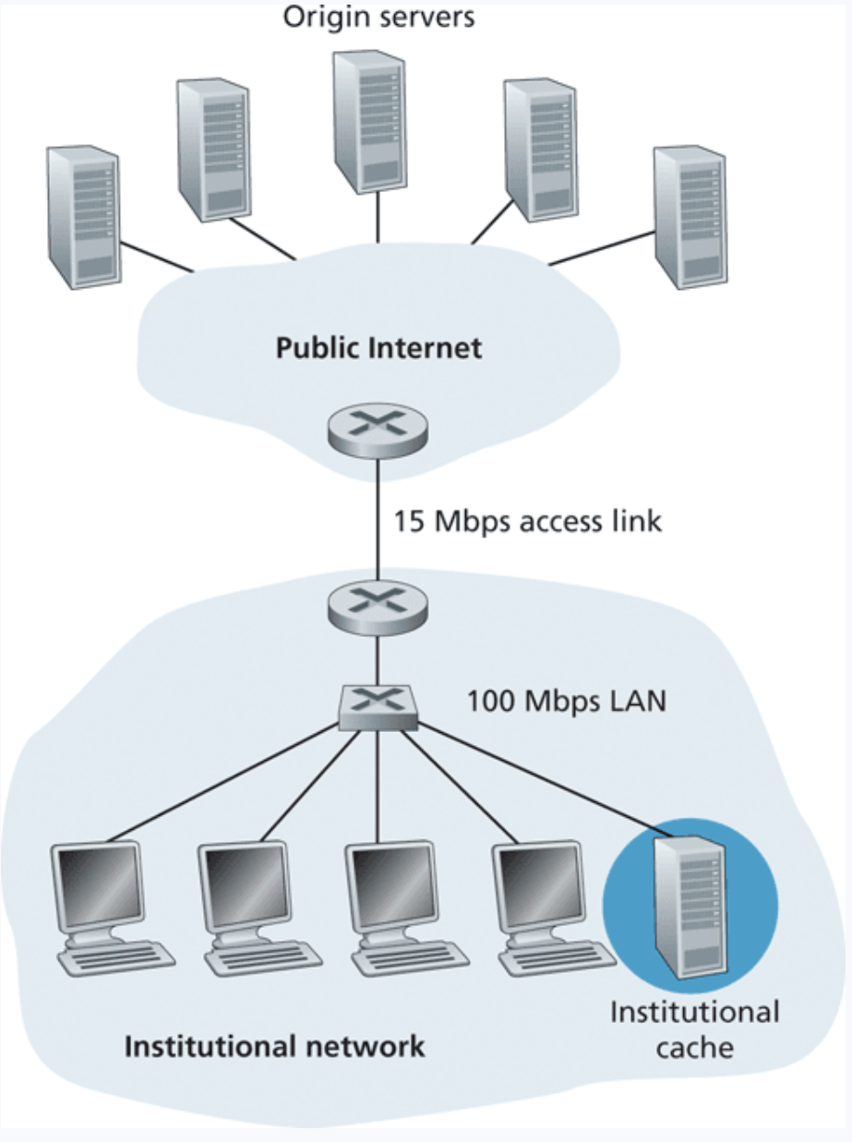
Web Caching

Slide 71

Web Caching
The cache might not always have the most up to date version in its local storage. “Stale” objects

Slide 72


Web Caching
Proxy Server
The cache might not always have the most up to date version in its local storage. “Stale” objects
Origin Server

Slide 73
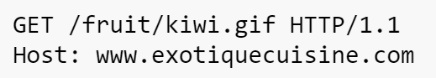
Web Caching
Proxy Server
The cache might not always have the most up to date version in its local storage. “Stale” objects
Origin Server

Slide 74
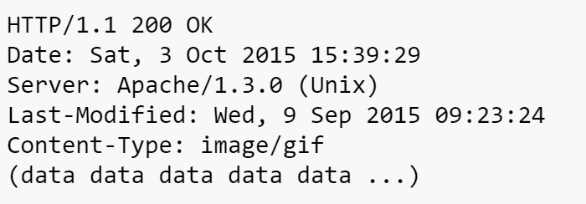


Web Caching
Proxy Server
The cache might not always have the most up to date version in its local storage. “Stale” objects
Origin Server

Slide 75
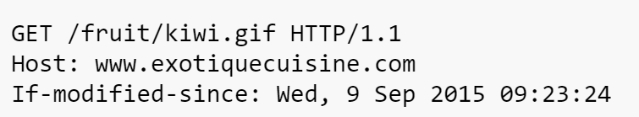
Web Caching
Proxy Server
The cache might not always have the most up to date version in its local storage. “Stale” objects
We can issue a conditional GET request to retrieve an object only if it's been recently modified
Origin Server

Slide 76
Web Caching
Proxy Server
The cache might not always have the most up to date version in its local storage. “Stale” objects
We can issue a conditional GET request to retrieve an object only if it's been recently modified
Origin Server

Slide 77
Web Caching
Proxy Server
The cache might not always have the most up to date version in its local storage. “Stale” objects
We can issue a conditional GET request to retrieve an object only if it's been recently modified
Origin Server

Slide 78
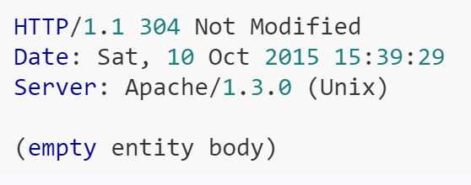
Web Caching
Proxy Server
The cache might not always have the most up to date version in its local storage. “Stale” objects
We can issue a conditional GET request to retrieve an object only if it's been recently modified
Origin Server

Slide 79
